Slide 1
JSP CODES and OUPUT SNIPPETS

Slide 2
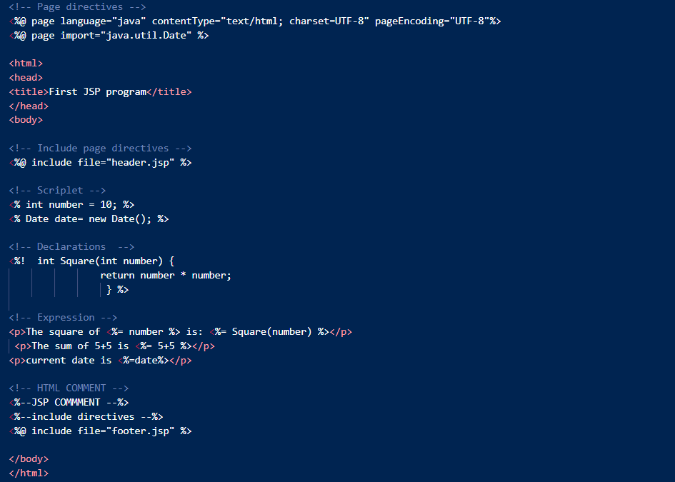
First.jsp (CODE)

Slide 3


header.jsp and footer.jsp (CODE)

Slide 4
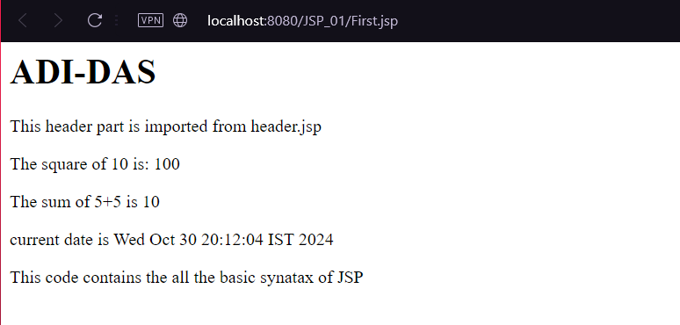
BASIC SYNTAX OF JSP (output)

Slide 5
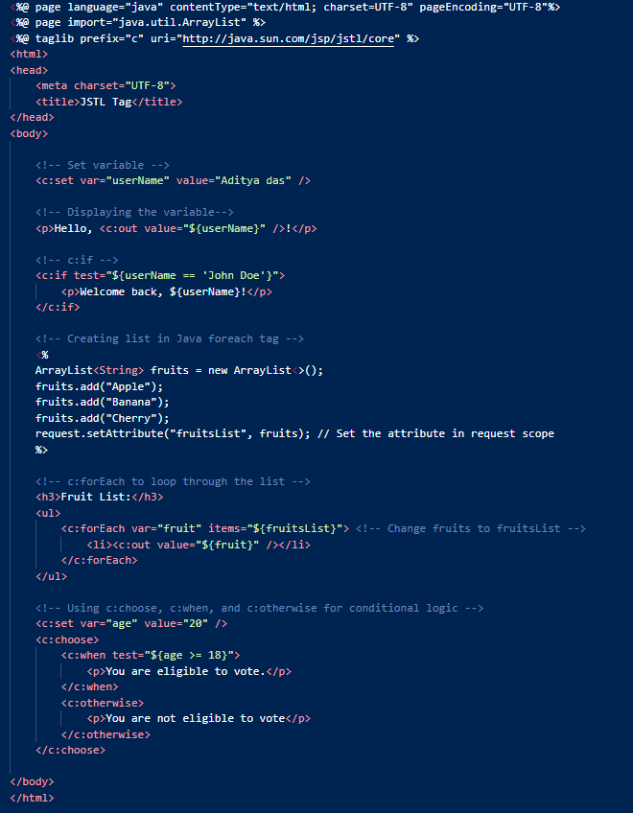
TAG_lib.jsp (Code)

Slide 6
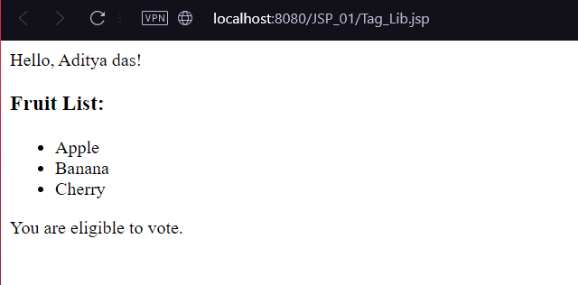
TAG_lib.jsp (output)

Slide 7
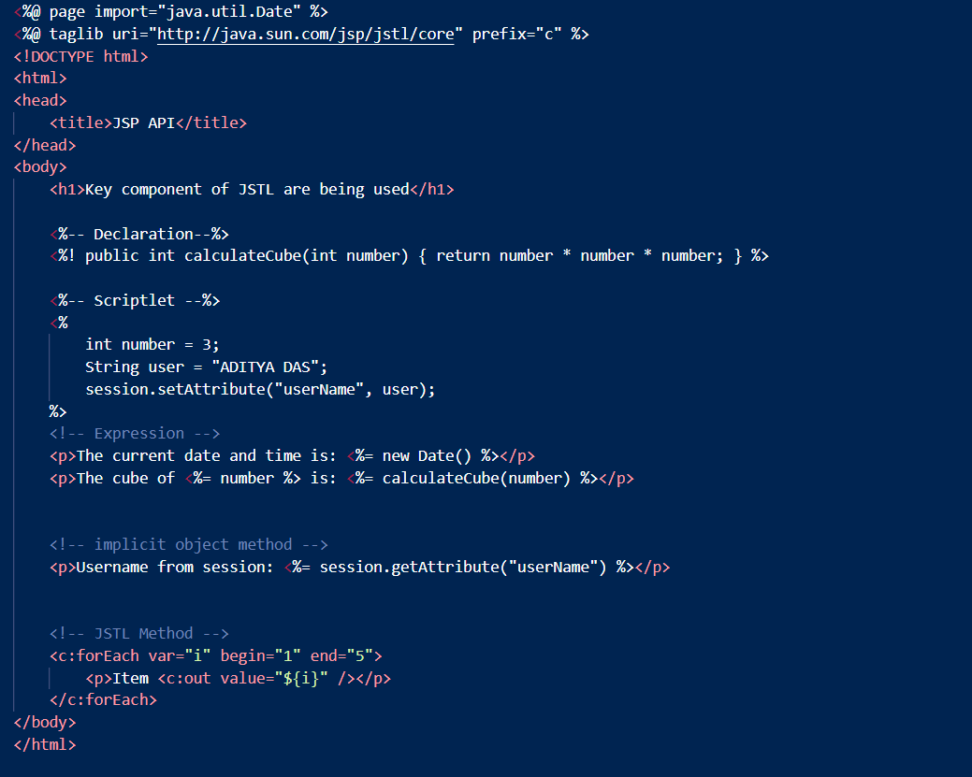
JSP_API.jsp (CODE)

Slide 8
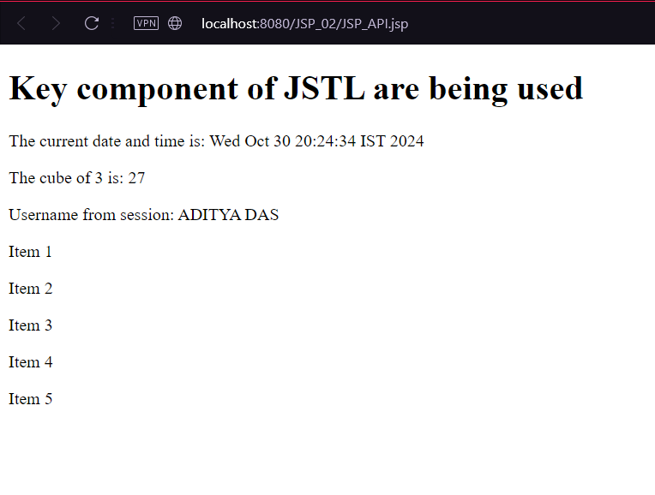
JSP_API.jsp (output)

Slide 9
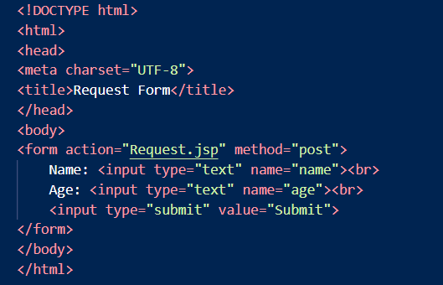
index.html (CODE)

Slide 10
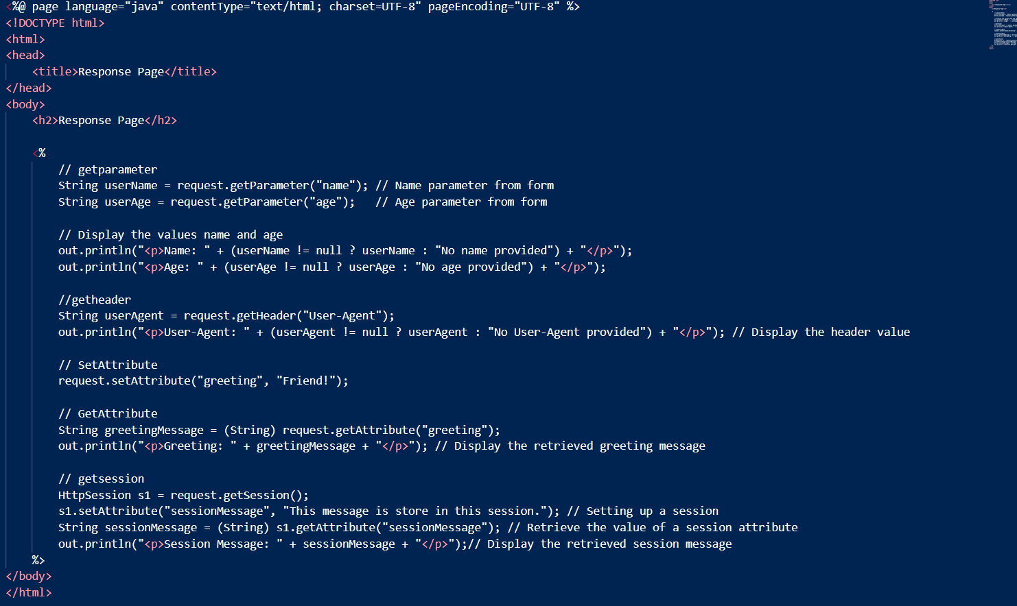
Request.jsp (CODE)

Slide 11
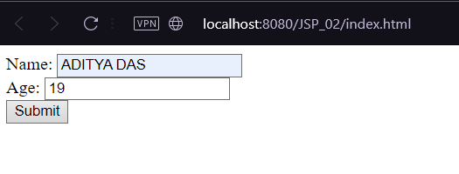
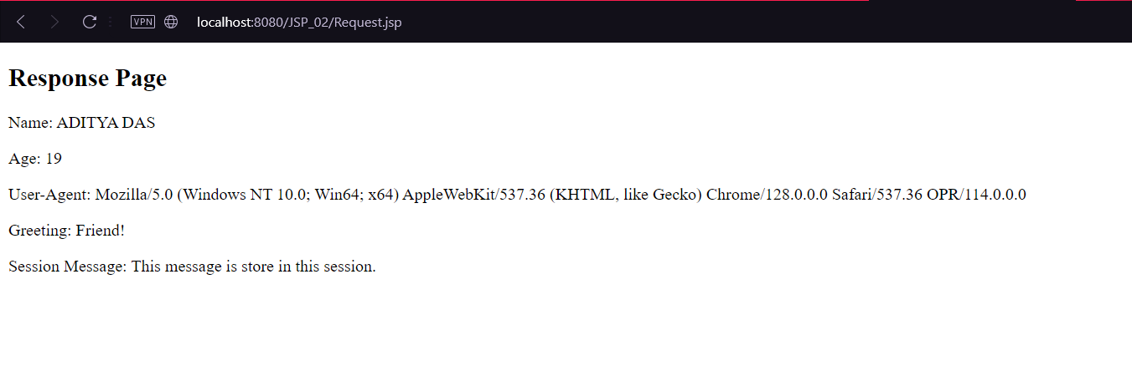
index.html,Request.jsp (output)

Slide 12
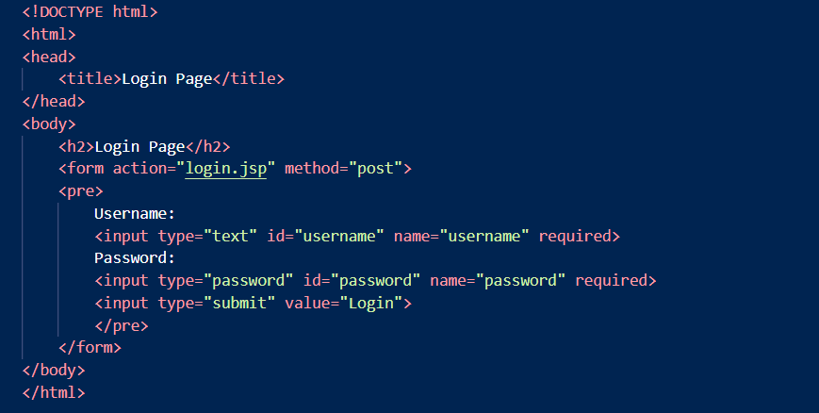
login.html(CODE)

Slide 13
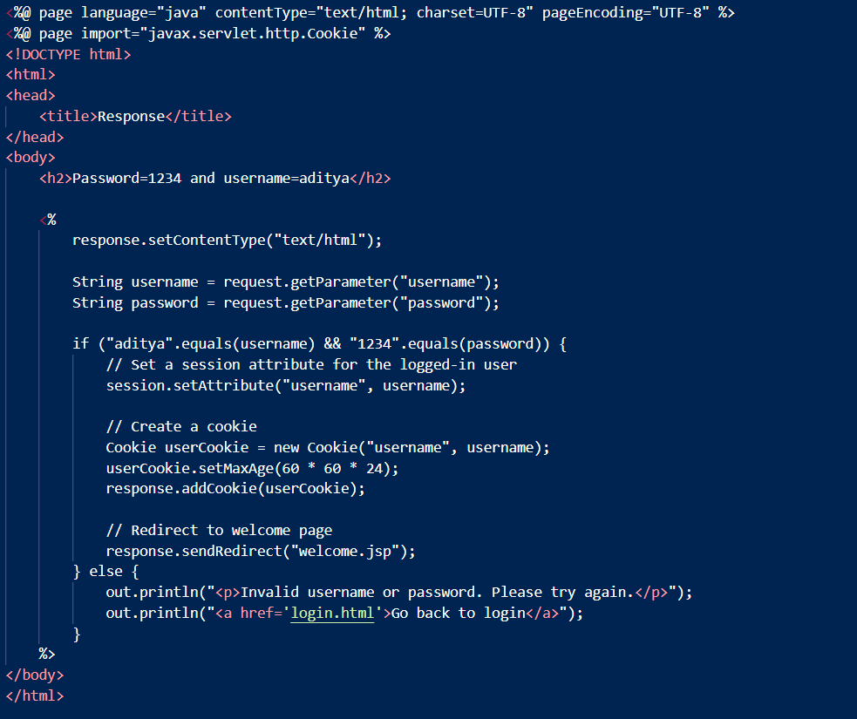
login.jsp(CODE)

Slide 14
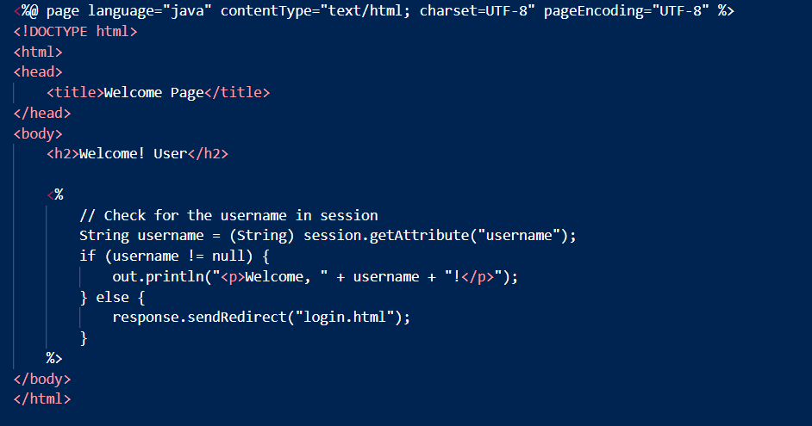
welcome.jsp(CODE)

Slide 15
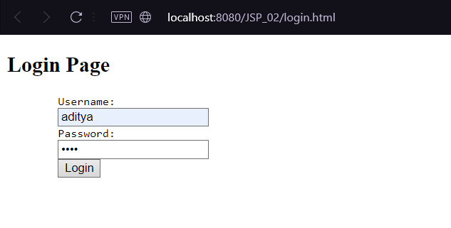
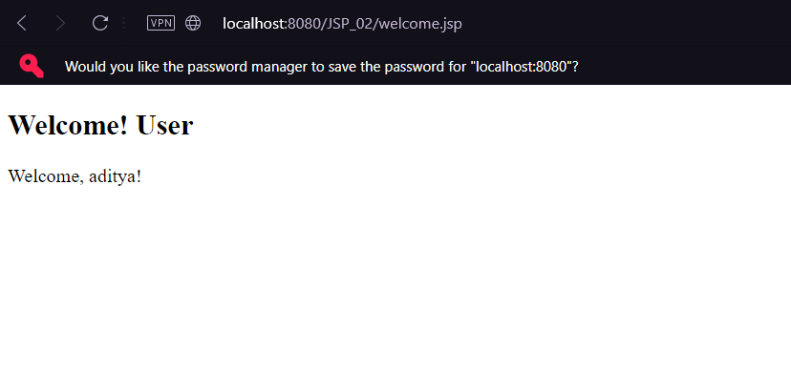
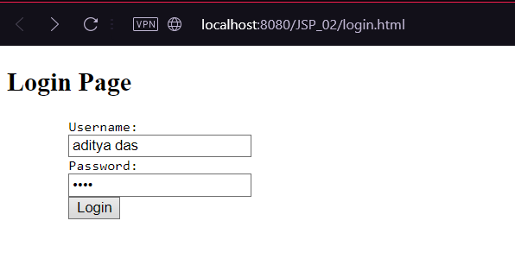
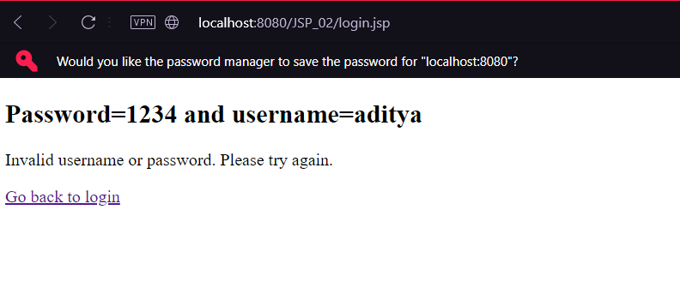
login.html,login.jsp,welcome.jsp(output)

Slide 16
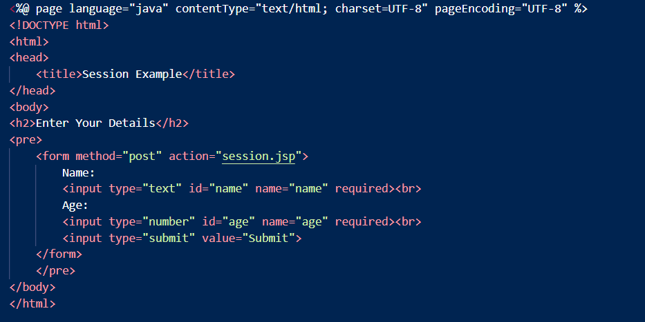
index.jsp(CODE)

Slide 17
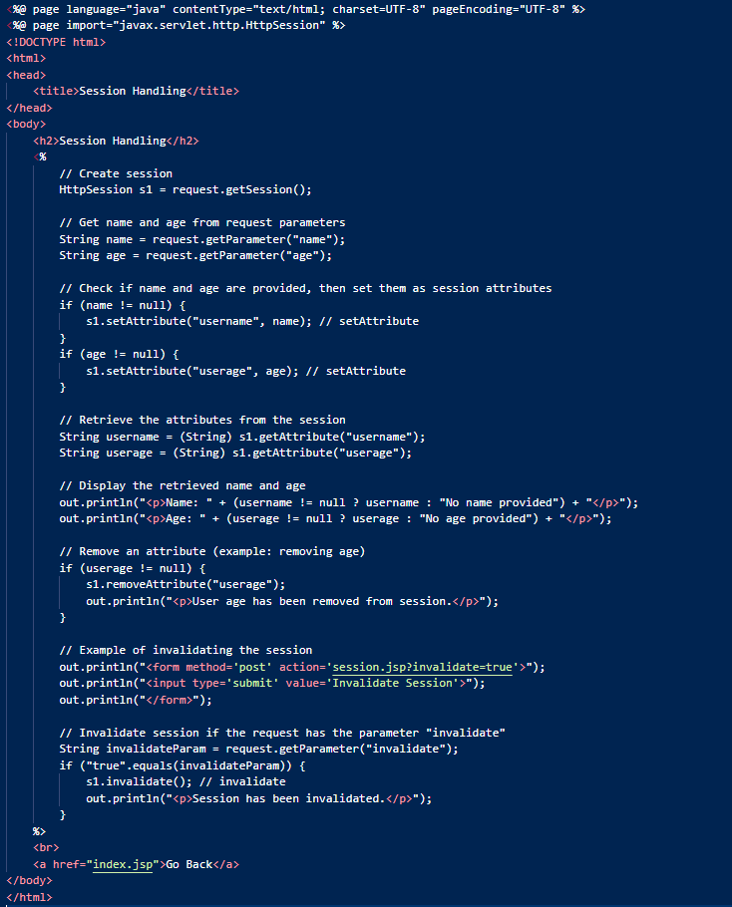
session.jsp(CODE)

Slide 18
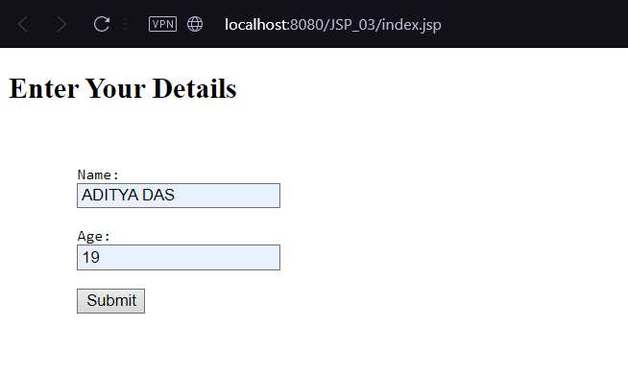
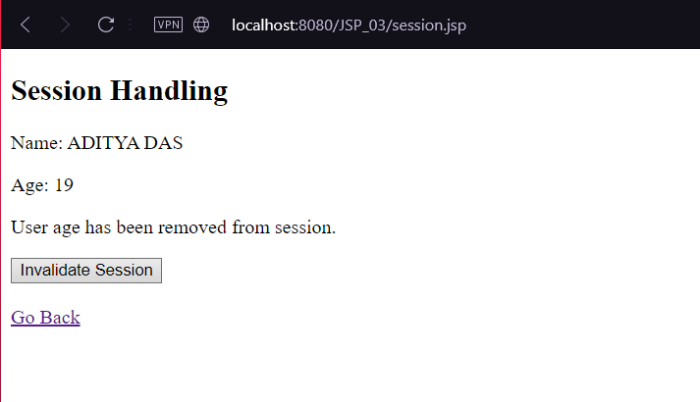
index.jsp,session.jsp(output)

Slide 19
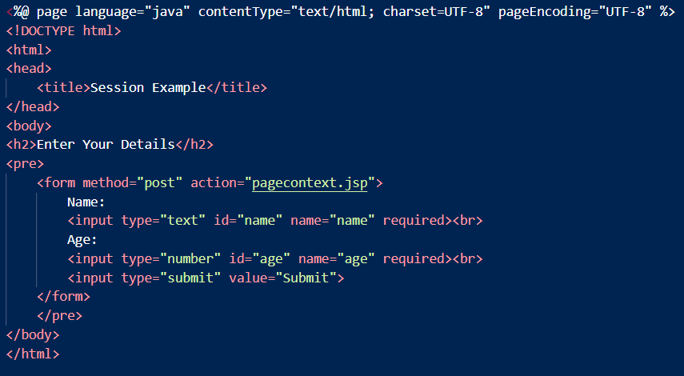
index1.jsp(CODE)

Slide 20
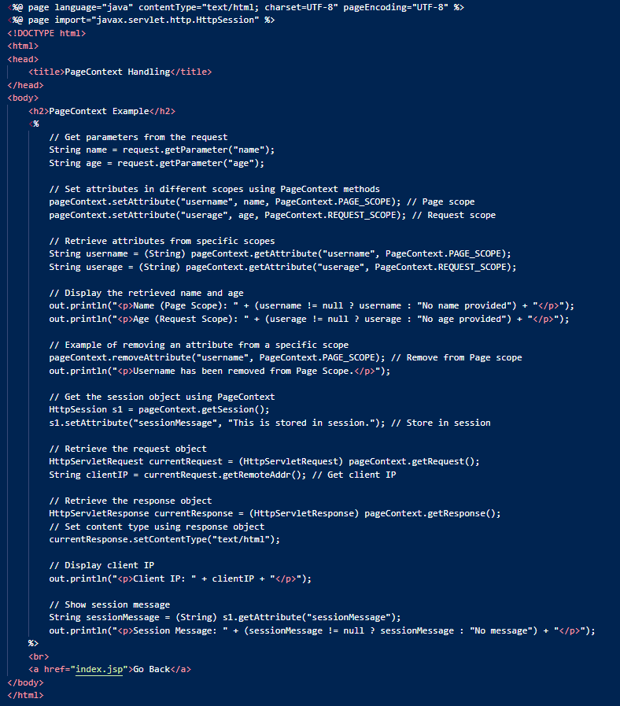
pagecontext.jsp (CODE)

Slide 21
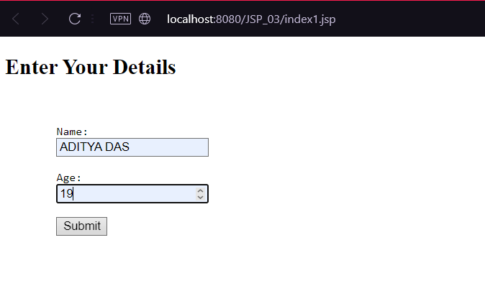
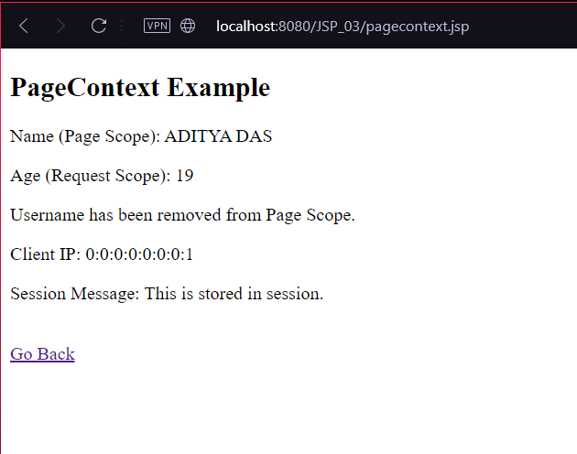
index1.jsp,pagecontext.jsp (OUTPUT)

Slide 22
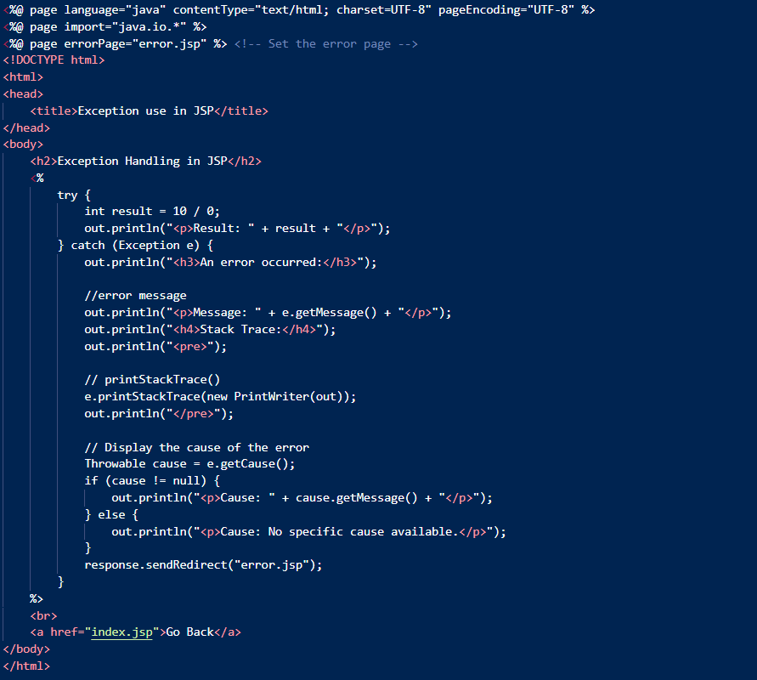
ExceptionHandling.jsp (CODE)

Slide 23
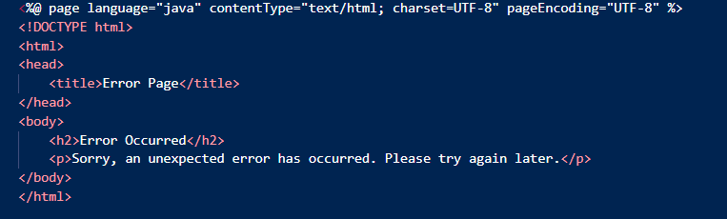
error.jsp (CODE)

Slide 24
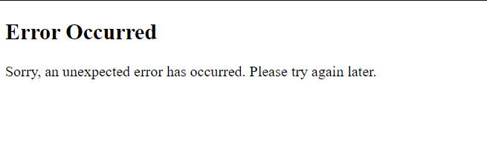
exceptionHandling.jsp,error.jsp (output)
It’s a part of exceptionHandling.jsp

Slide 25
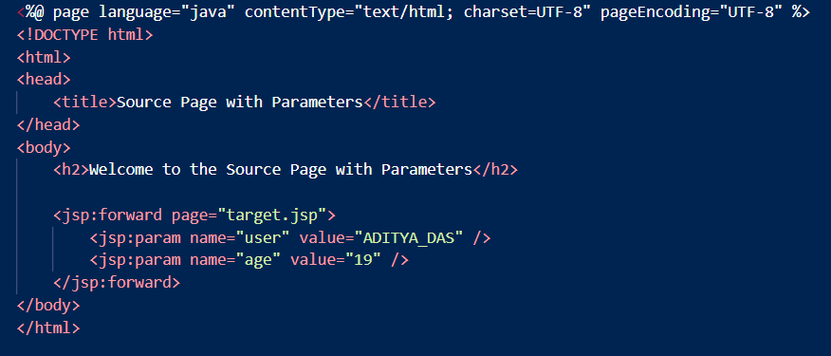
forward.jsp (CODE)

Slide 26
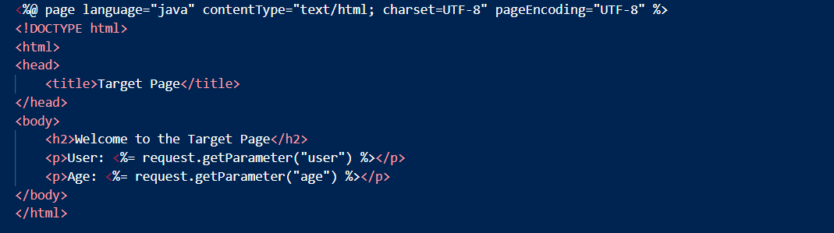
target.jsp (CODE)

Slide 27
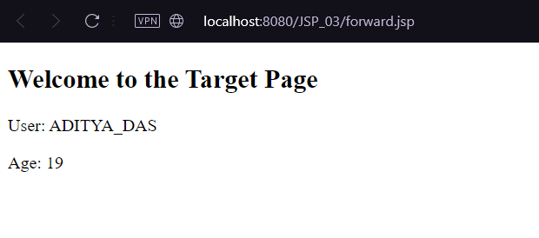
forward.jsp,target.jsp(output)

Slide 28
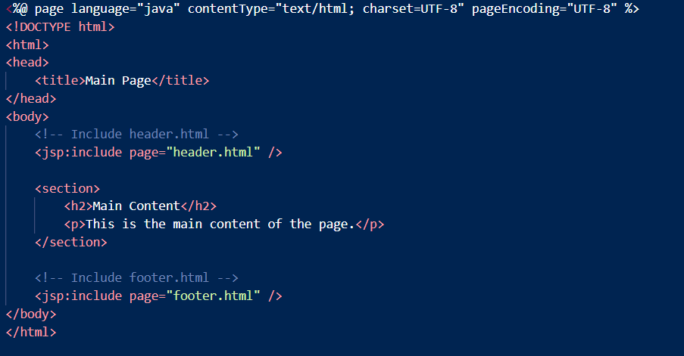
include.jsp (CODE)

Slide 29
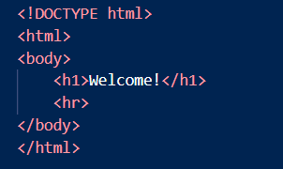
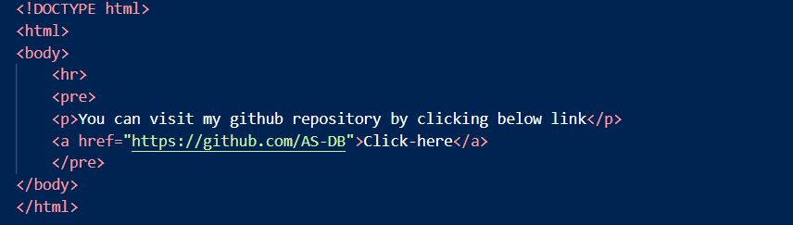
header.html, footer.html (CODE)

Slide 30
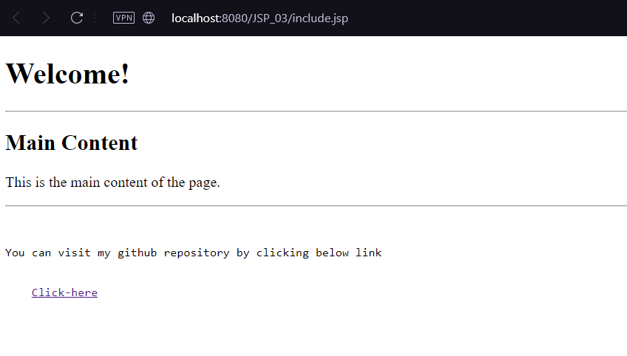
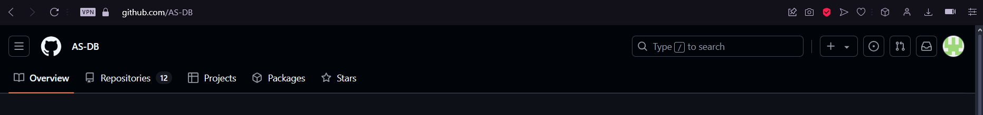
include.jsp,header.html,footer.html(output)
After clicking click-here it will redirect to below page.

